Slide 1


Dive into Black Gold
By: The Data Babes
Mia Brodsky
Dawn Burns
Bethany Jones

Slide 2

Who We Are
Mia Brodsky
Former Certified Pharmacy Technician originally from New Mexico now living in Texas.
Background in Civil Engineering and Water Remediation.
Aspiring Data Scientist.
Lover of the environment and digging deep.

Slide 3

Who We Are
Dawn Burns
With an Early Childhood Education degree I’ve worked mostly in school settings. I Enjoy teaching Sunday School the most. God is my rock.
I grew up in Scituate, Massachusetts and currently live in Hampton Roads, VA. I’m hoping to find a job close to my daughter and her family in Holly Springs, NC.
I am a budding Data Scientist and have enjoyed my learning experience at Entity Academy.
I look forward to challenges and finding ways to help my future workplace make more money and run more efficiently in a safe environment.

Slide 4

Who We Are
Bethany D. Jones
Medical Industry: Certified Pharmacy Technician for over ten years.
Logistics Industry: Finance, Human Resources, Driver Management, Dispatch and Brokerage for over five years.
Embarking on my journey as a Data Analyst in the near future;
Aspiring Front End Developer and UI/UX Developer.
Currently residing in the DFW area.

Slide 5
Introduction
Oil and gas prices are notoriously difficult to predict.
There are many factors going into the price of crude oil and gas including international events, war, production speed, and demand.
They impact many parts of our lives as US citizens, determining how much we travel and how far, what kind of vehicle we purchase, and sometimes even who we vote for as president.
If we can create an accurate model of where crude oil and gas prices are going to go, we can help the American population plan ahead and even hedge for the best prices.
Here we will explore the last 20 years of oil and gas prices.

Slide 6

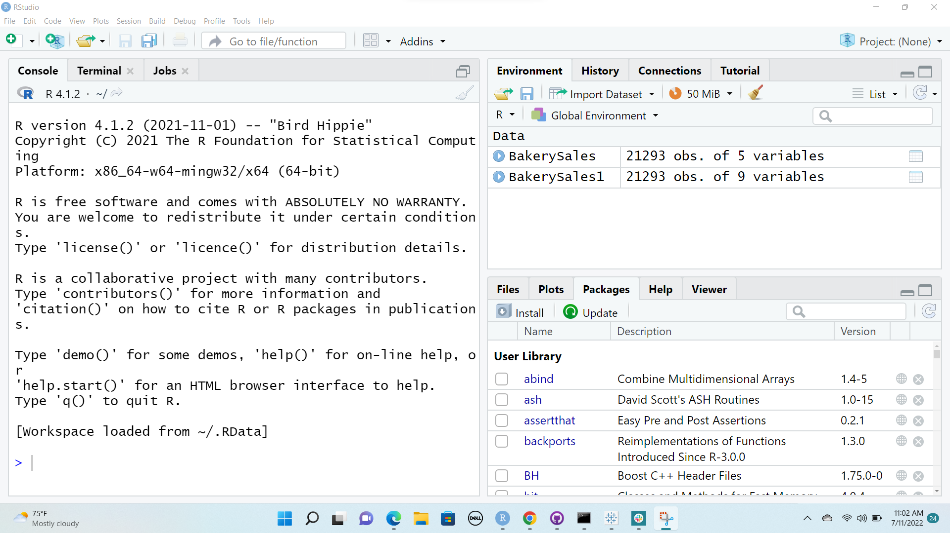
MeMethods
We sourced data from the Energy Information Administration for our price per gallon set and from the government website data.gov for our barrel prices.
Upon exploratory analysis, we decided a time series model would work best with our datasets.
Using R-Studio we created a time-series model called an ARIMA model. This model uses time as our independent variable and oil price as our dependent variable to answer our first question: What will crude oil prices look like for the next 10 years?

Slide 7
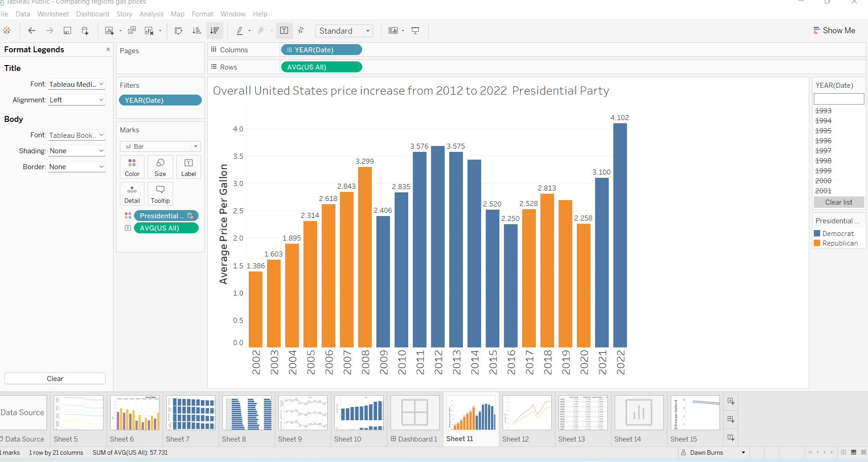
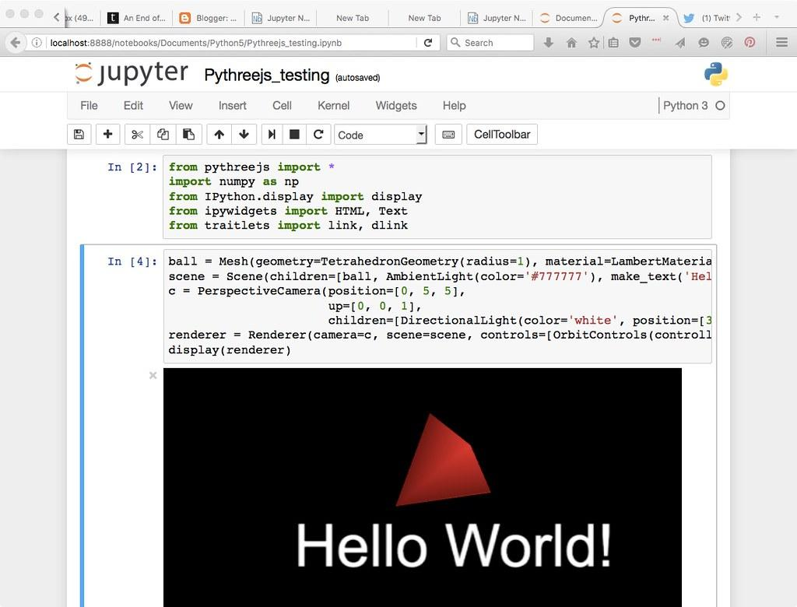
Methods Continued
With Tableau, assisted by some data wrangling in Python, we followed our curiosity; how do the prices compare per region? What were the national average gas prices over the last 10 years? How did the prices change over time? How did the presidential party in office affect the gas prices?
This led us to also consider, what other factors go into the pricing of crude oil and gas?
And finally to dive into how barrel prices differ from gallon prices

Slide 8
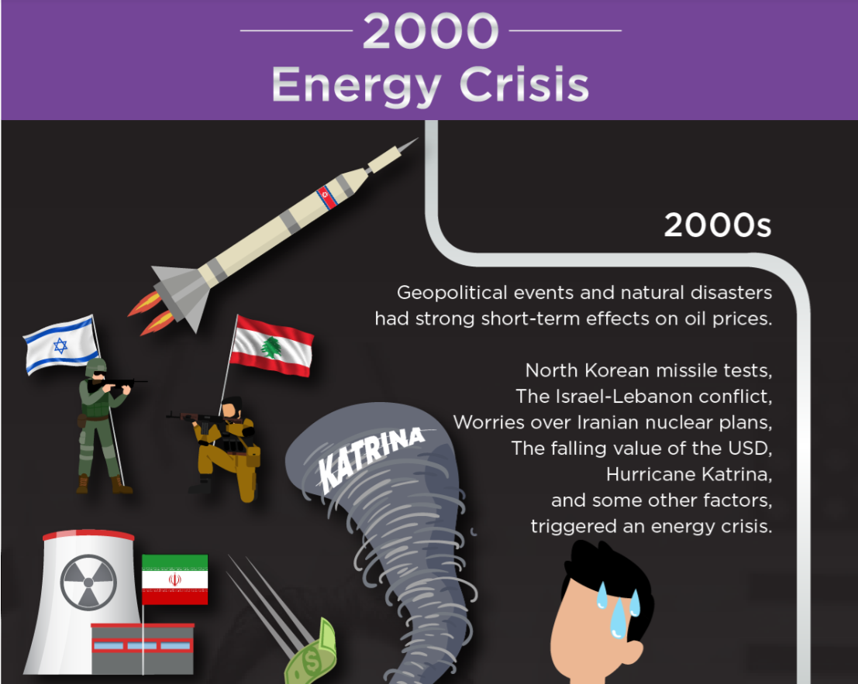
Major Events Impacting Oil and Gas Prices
source:https://axioryintelligence.com

Slide 9
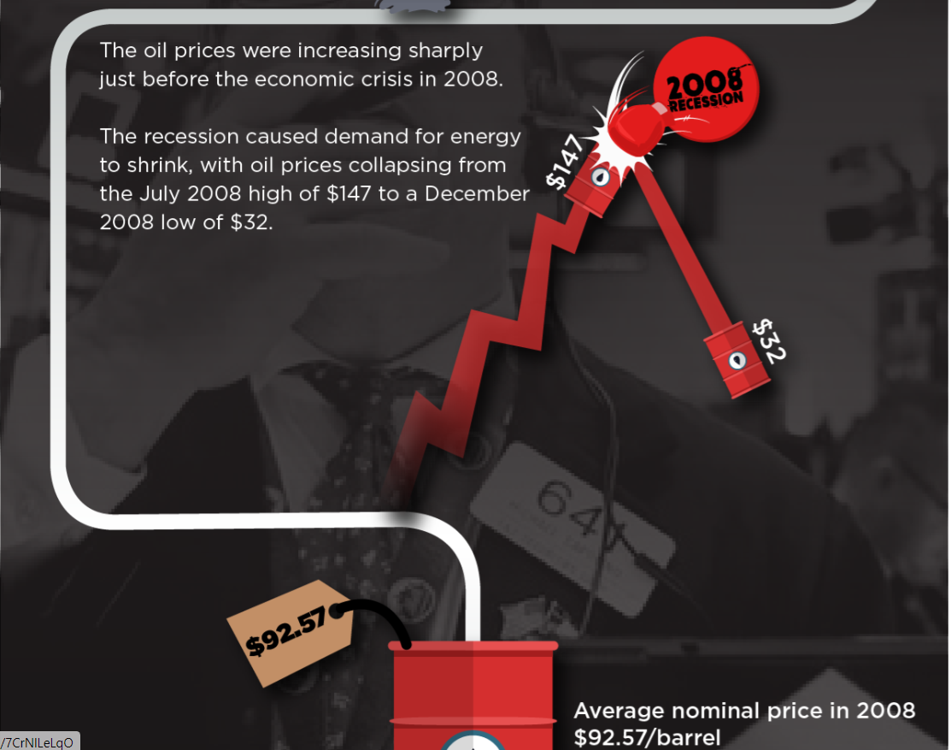
Major Events Impacting Oil and Gas Prices
source:https://axioryintelligence.com

Slide 10
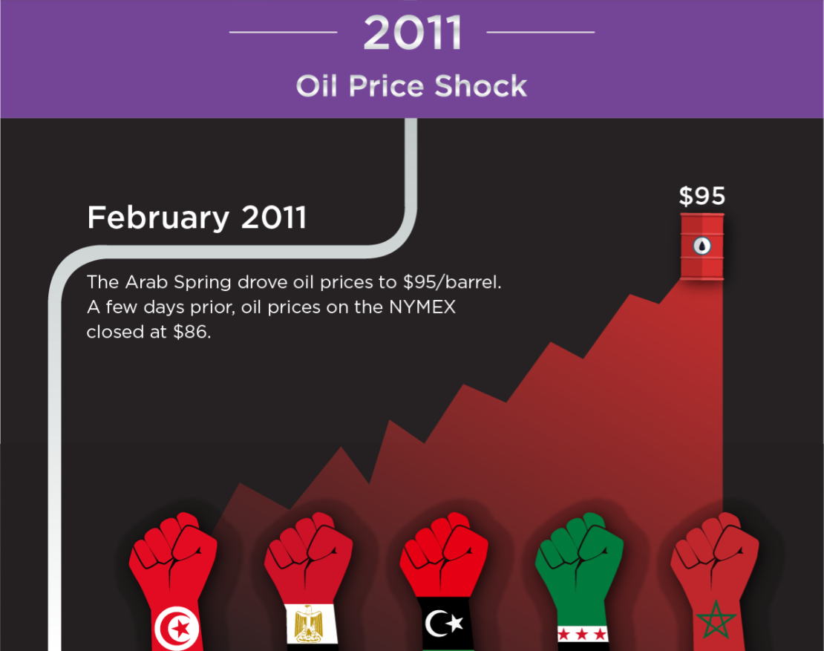
Major Events Impacting Oil and Gas Prices
source:https://axioryintelligence.com

Slide 11
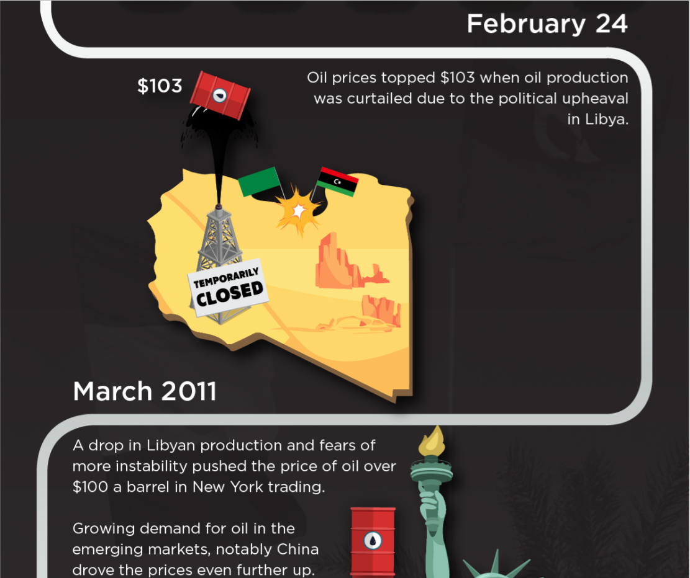
Major Events Impacting Oil and Gas Prices

Slide 12
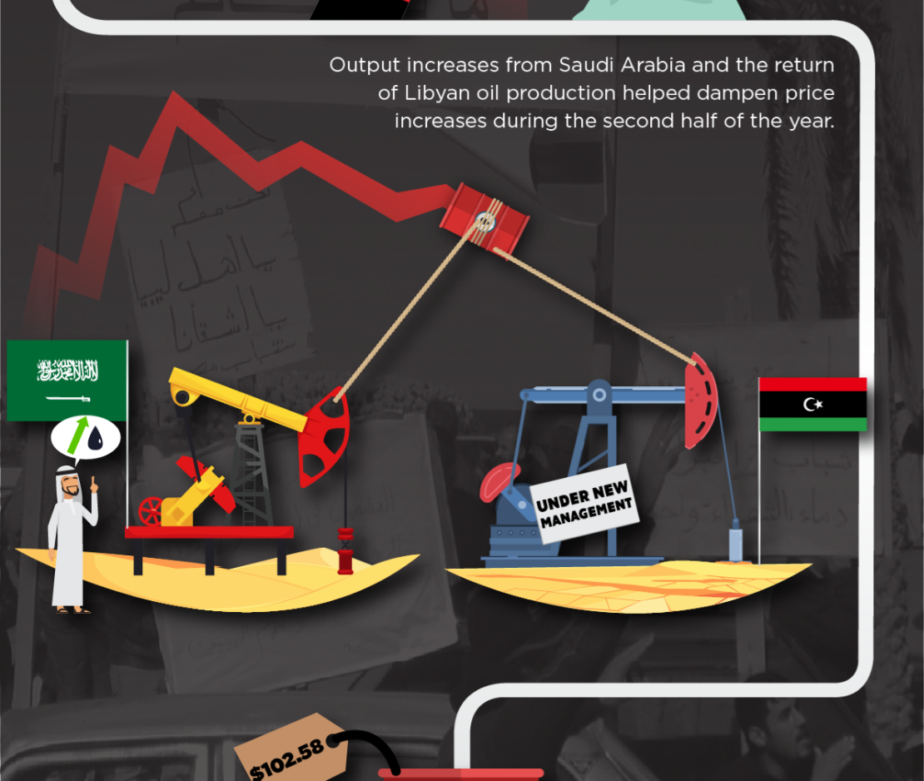
Major Events Impacting Oil and Gas Prices
source:https://axioryintelligence.com

Slide 13
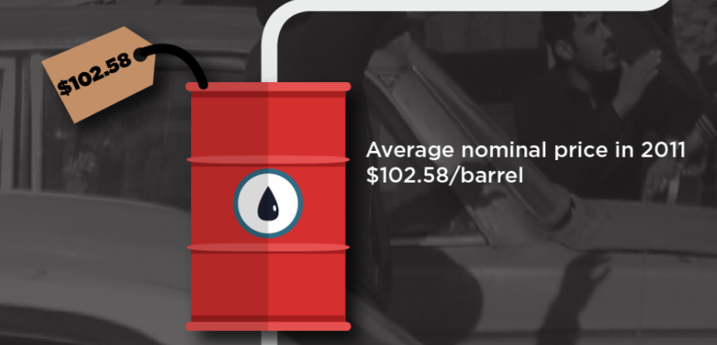
Major Events Impacting Oil and Gas Prices
source:https://axioryintelligence.com

Slide 14
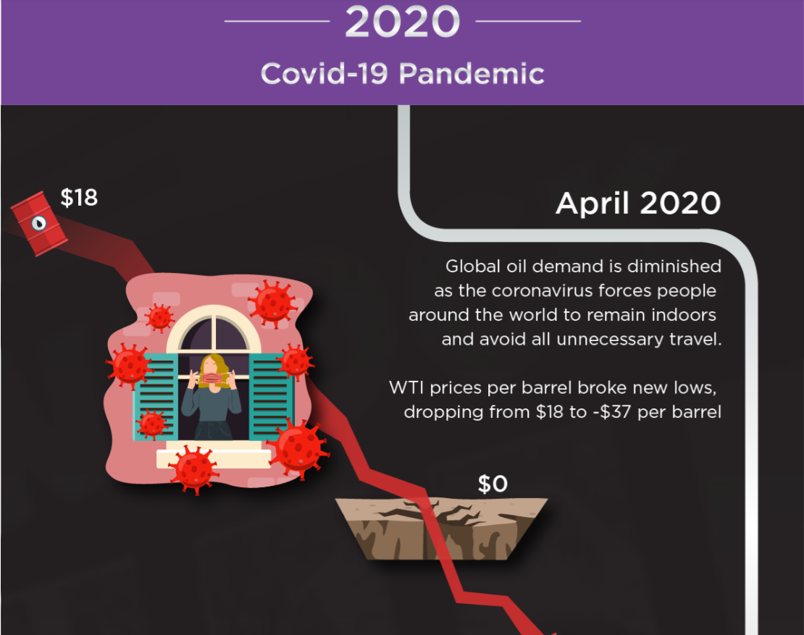
Major Events Impacting Oil and Gas Prices
source:https://axioryintelligence.com

Slide 15
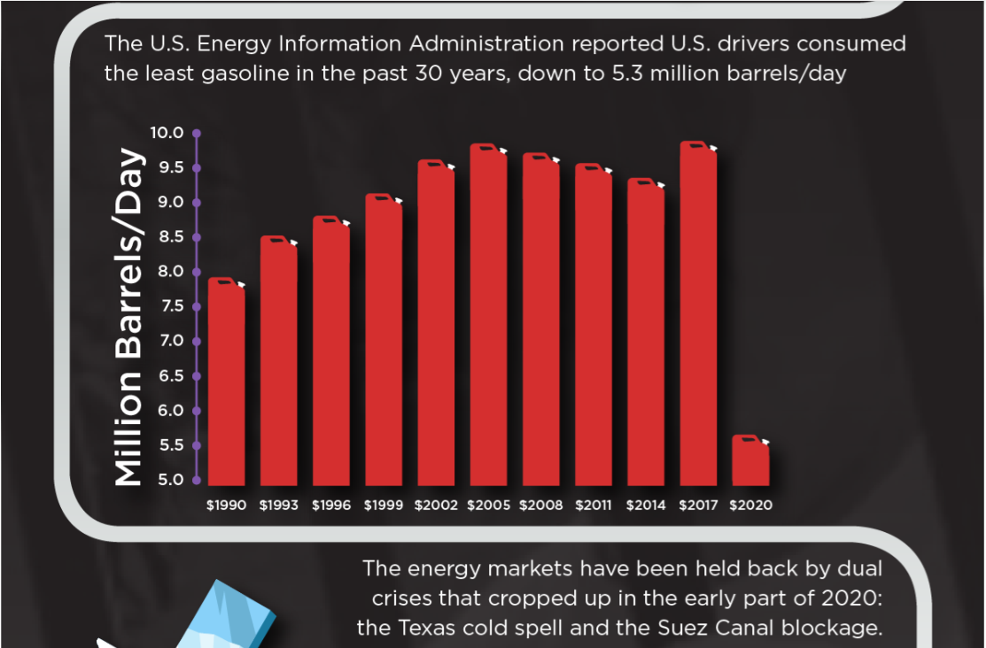
Major Events Impacting Oil and Gas Prices
source:https://axioryintelligence.com

Slide 16
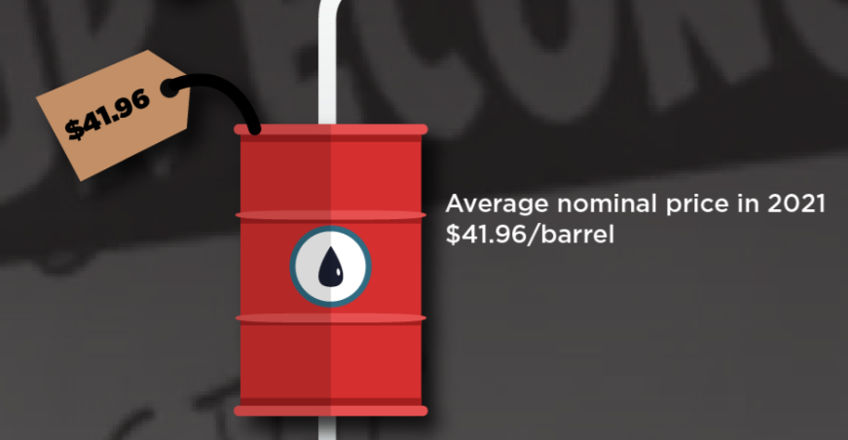
Major Events Impacting Oil and Gas Prices
source:https://axioryintelligence.com

Slide 17
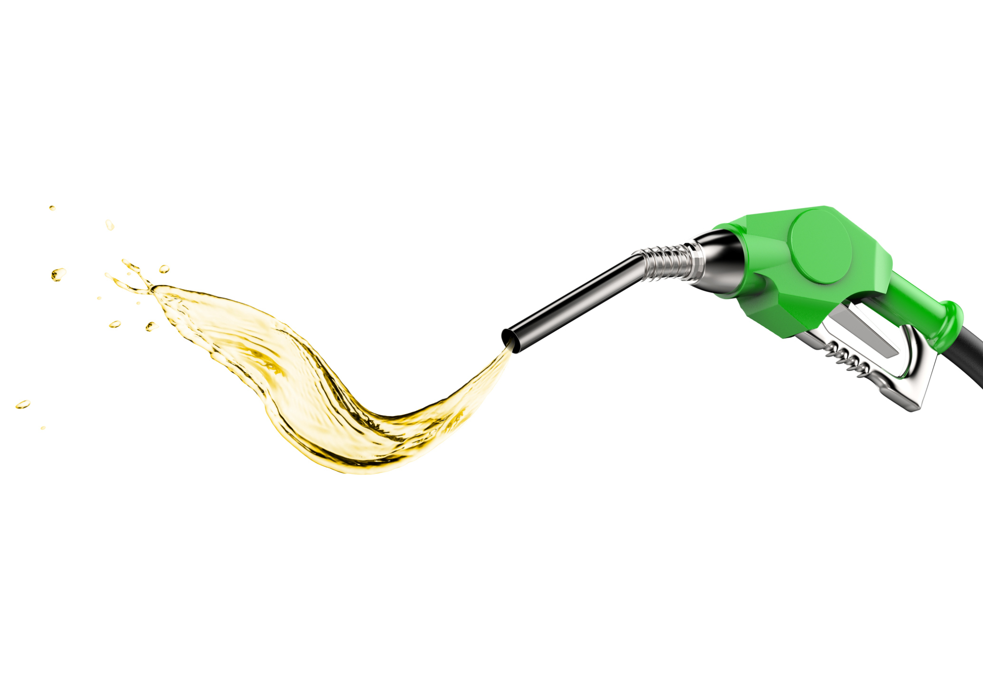
Results
By the end of 2022, prices are foreseen to go back down to 3.69 per gallon but not before they rise to a nearly $5 per gallon average for the country.
Forecast Lo 95 Hi 95
2022 Q2 3.869131 3.17927544 4.558986
2022 Q3 3.923571 2.94796831 4.899174
2022 Q4 3.689933 2.49506883 4.884798

Slide 18
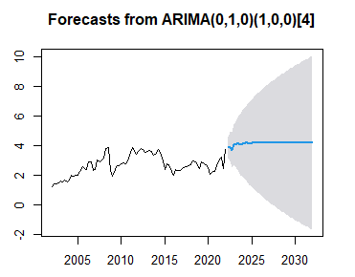
Results
According to our model, this is what future gas prices may look like:
Our graph is based on our data ending in May 2022.
It forecasts what we already know by now which is that the prices will rise a bit more and then dip back down before tapering off.
This result illustrates a 95% confidence interval.
The shaded area represents potential growth or decline based on extraneous factors.
The blue line represents the path most likely taken.
Point Forecast

Slide 19
Results
Forecast Low High
2030 Q1 4.190551 -1.01804948 9.399151
2030 Q2 4.190556 -1.10657297 9.487684
2030 Q3 4.190558 -1.19364369 9.574760
2030 Q4 4.190548 -1.27934093 9.660437
2031 Q1 4.190564 -1.36369009 9.744818
2031 Q2 4.190565 -1.44679310 9.827924
2031 Q3 4.190566 -1.52868942 9.909822
2031 Q4 4.190563 -1.60943300 9.990560
2032 Q1 4.190568 -1.68906043 10.070196
Notes:
The mean averages out over time as external factors make it more unclear what prices will look like.
The average price could go as high as $10.07 per gallon in 2032, but will most likely stay closer to $4.19.
The potential lows go into the negatives, but that is also unlikely even though in 2020 price per barrel hit an all-time low of -$37.

Slide 20
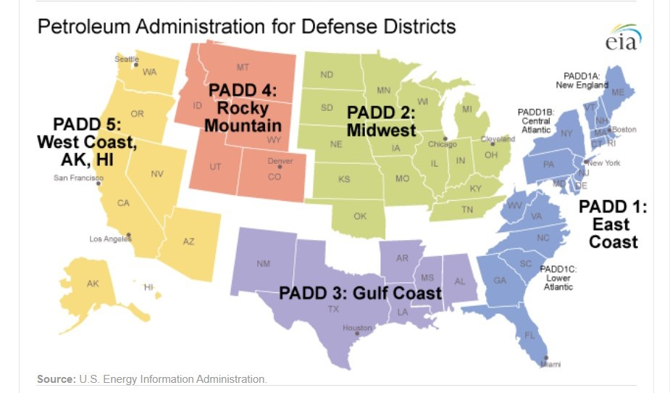
While utilizing Tableau we analyzed the following regions
East Coast
West Coast
Gulf Coast
Midwest
New England
Rocky Mountain

Slide 21
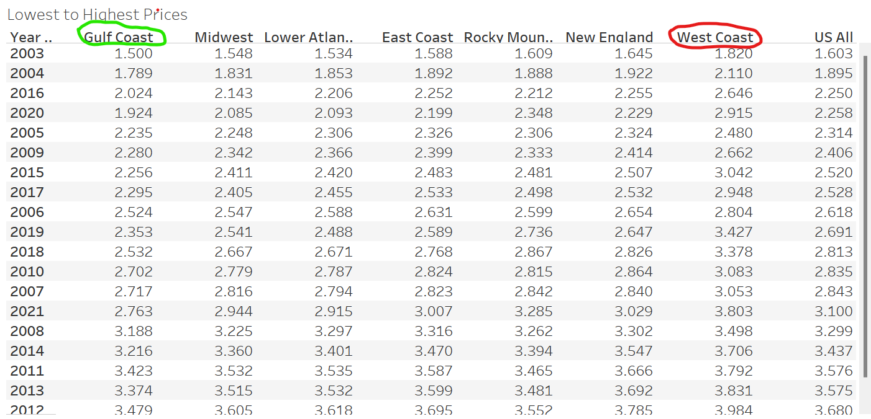
According to this dataset, the Gulf Coast had the cheapest gas and the West Coast had the most expensive….
Let’s take a closer look…

Slide 22
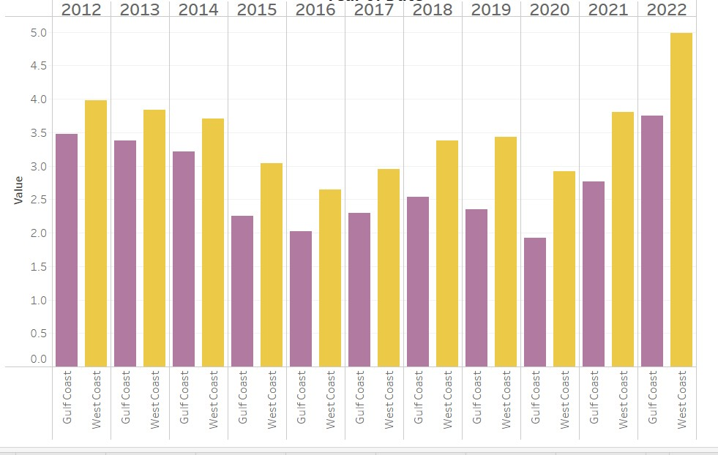
When comparing the area with the highest gas prices per gallon(West Coast) to the area with the lowest gas prices per gallon (Gulf Coast) these were the results:
Year Price Difference
2012 $.50
2013 $.50
2014 $.50
2015 $.80
2016 $.60
2017 $.70
2018 $.90
2019 $1.50
2020 $1.00
2021 $1.00
2022 $1.50
In ten years the price difference increased one dollar per gallon

Slide 23
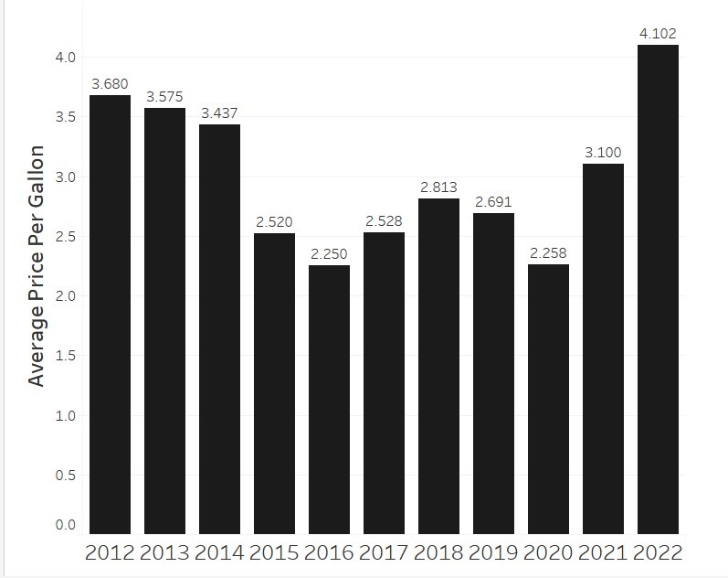
United States Average Gas Prices Over the Last Ten Years:
The largest increase was over the last two years where the price went up a dollar from 2020 to 2021 and another dollar increase from 2021 to 2022.

Slide 24

There are many factors that affect gas prices, as we mentioned earlier, but we chose to look closer and see if political parties could have had anything to do with it…

Slide 25
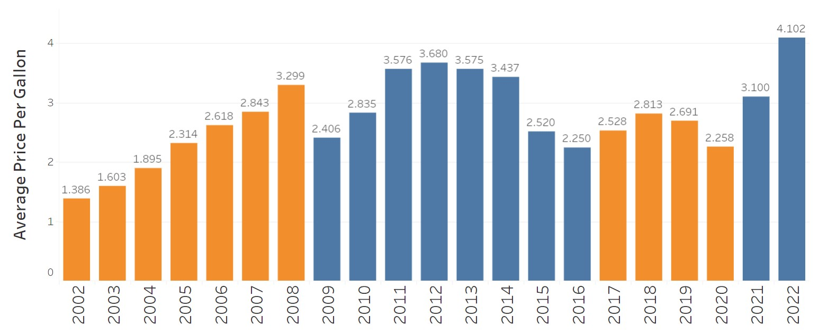
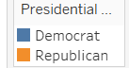
Average gas prices in United States from 2012 to 2022
Looks like when the Democrats are in office the average prices increased more and were overall mostly higher than when there was a Republican in office.

Slide 26
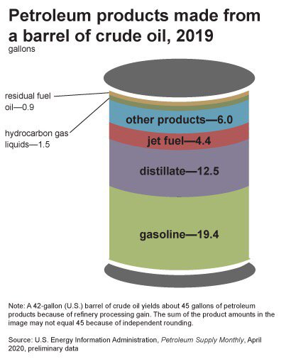
Barrels vs. Gallons
To see how that translates to us as consumers, we transformed it into price of gas per barrel which comes out to 19.4 gallons of gasoline per barrel.
Each barrel is 42 gallons which comes out to 45 gallons of petroleum products after refinery process gain.

Slide 27
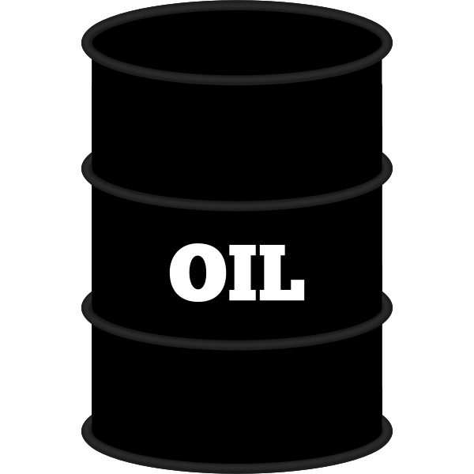

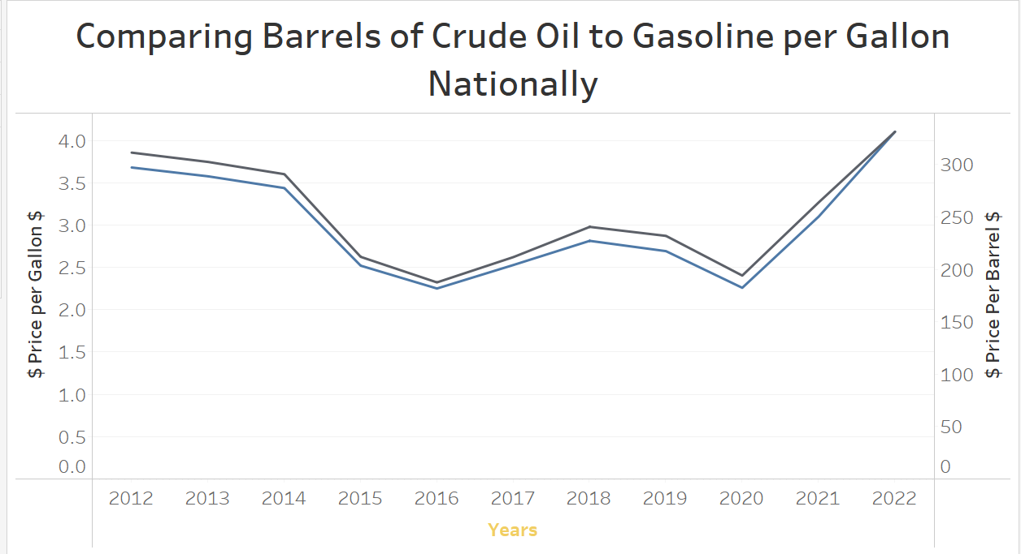
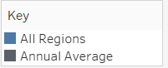
Comparing crude oil prices by the barrel to the price of gasoline per gallon
They are pretty steady with each other, with the gap closing in 2022

Slide 28
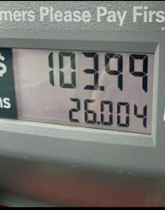
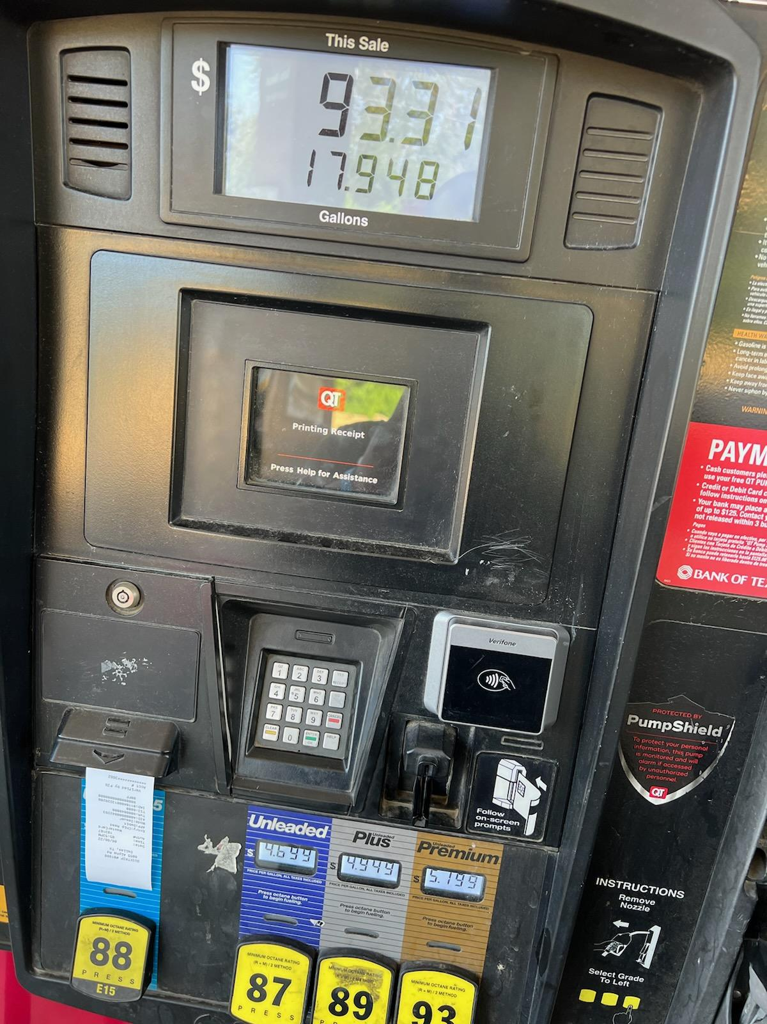
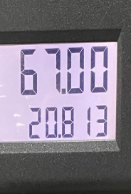
Summary
Over the last 10 years, the inflation of oil and gas prices
have been fluctuating for numerous factors; majority of the recent
factors such as the Covid-19 pandemic, presidential elections,
geopolitical events and natural disasters show the impacts
made on our daily lives and the consumption of gas prices.
Over the next 10 years, we can project an average stability
Of gas prices based on a 95% confidence interval. This does not include
Calculations of future major factors that may occur affecting gas and barrel
pricing. By 2032, the price of gas may go as high as $10 USD
per gallon based on the forecast set by ARIMA.

Slide 29
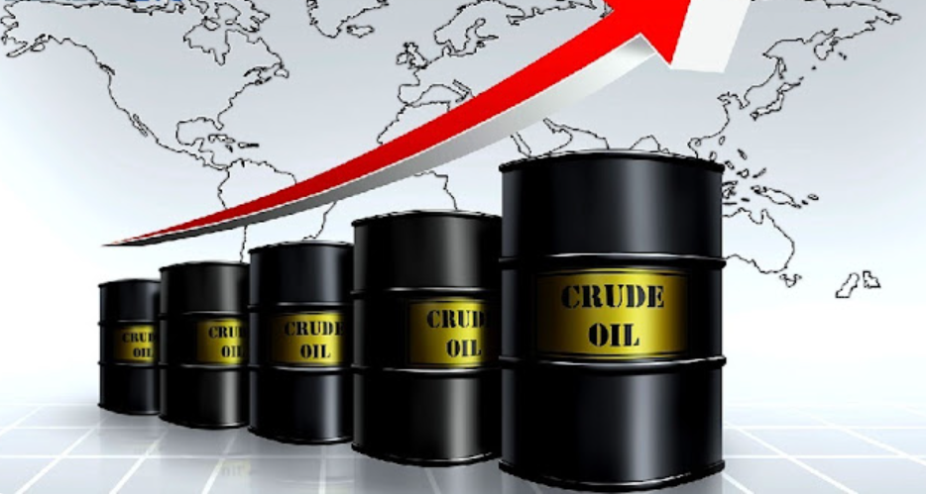
Conclusion
What will crude oil prices look like for the next 10 years?
Crude oil prices are now matching and surpassing the
prices of 2012. In the near future, look to see a projection that steadily
increases with minor differences in price.
How do crude oil and gas prices vary among United States regions?
Based on the analysis, the price of crude oil and gas have maintained a very close balance over the years. As of 2022, the gap is closed between the
two aspects. In fact, the visualization of the data reflects the peak of cost revealing very similar numbers from the year 2012.
Which region in the country is the most inexpensive to live and travel?
The most inexpensive region to live and travel to will be the Gulf Coast: spanding from New Mexico to Alabama with gas prices valuing between 3.5 to 4.0 per gallon as of May 2022.

Slide 30
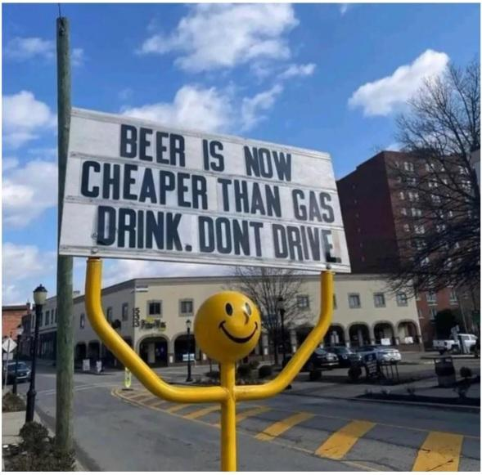
Conclusion
How do the prices compare per region?
A comparison was made by dividing the US into five regions.
Overall, the West Coast and the Gulf Coast regions varied the
most drastically; the West Coast being the most expensive.
West Coast
New England
Rocky Mountain
Midwest
Gulf Coast
What were the national average gas prices over the last 10 years?
The National Average of gas prices over the last 10 years increased
by $2 USD per gallon; contributing To the largest increase between 2020 and 2022.

Slide 31
Conclusion
How did the prices change over time?
Between the years 2012 to 2014 , the price of gas was steady at the difference rate of approximately $0.50 as there were no major differences in price that were detected. There was a $0.30 increase difference to $0.80 detected in 2015 that gradually decreased; then made another comeback in the year 2018 at $0.90 difference. As the Global Pandemic began the difference in price began to surpass the $1 USD mark.
How did the presidential party in office affect the gas prices?
Based on the data analysis results, the gas prices showed to be lower during the years the Republican Party were in office. Higher gas prices were recorded while the Democratic Party were in office. The highest average cost per year for the Democratic Party is 2022 at 4.102 and counting. The highest average cost per year for the Republican Party was in 2008 at 3.299 per gallon.
What other factors go into the pricing of crude oil and gas?
The Economic Crisis of 2008
MidEast & Chinese Geopolitical Events
Natural Disasters such as the Texas Cold Spell and Hurricane Seasons
The Global Pandemic
Observation of political parties in office

Slide 32
Questions?

